Slide 1


A Comparative Study of Techniques for Addressing Class Imbalance in Machine Learning
Capt Brandon Hosley
The views expressed in this presentation are those of the author(s) and do not reflect the official policy or position of the United States Air Force, the Department of Defense, or the United States Government.

Slide 2
Overview
Motivation
Datasets
Methodology
Analysis
Results
Conclusion
Questions

Slide 3
Motivation of Research
Addressing class imbalance is a broad problem within ML
Many different techniques have been shown to be very effective
How do these perform under different imbalances?

Slide 4
Datasets - Diabetes
Binary classification via features
Collected by CDC using BRFSS
Original dataset has 441,455
Kaggle set is 70,692
Balanced and Cleaned
Available at: https://www.kaggle.com/datasets/prosperchuks/health-dataset

Slide 5
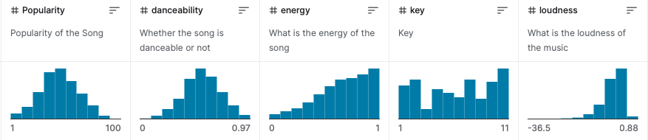
Datasets - Music Genre Classification
Multi-class via features
Provenance withheld by originator
Features are highly subjective measures
Available at: https://www.kaggle.com/datasets/purumalgi/music-genre-classification

Slide 6

Datasets - Cats-vs-Dogs
Binary classification via images
A larger version of the Tensorflow example set
Original set produced from Microsoft captcha research
Images were sourced from PetFinder.com listings
Available at: https://www.kaggle.com/datasets/shaunthesheep/microsoft-catsvsdogs-dataset

Slide 7
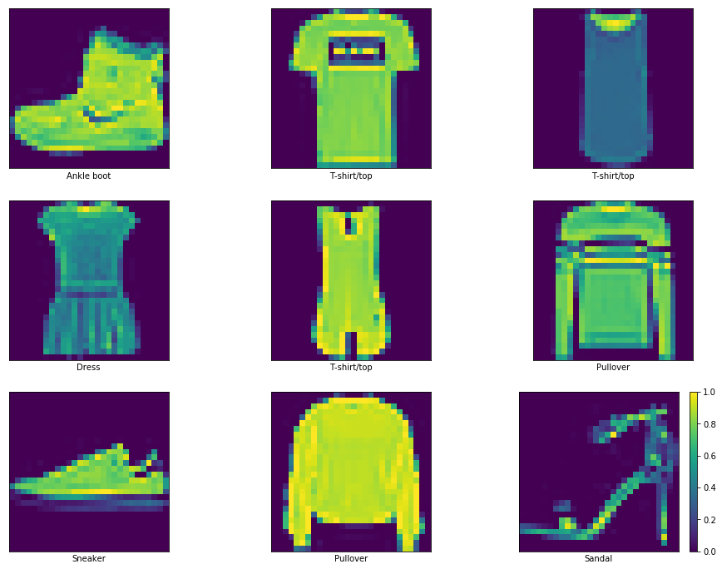
Datasets - Fashionmnist
Multi-class via images
The larger version of the set available through Tensorflow
Well established, clean, benchmarking dataset
Available at: https://www.kaggle.com/datasets/zalando-research/fashionmnist

Slide 8
Datasets - Toy Dataset
Purely Synthetic feature dataset
Generated data confirms specifically to statistical distributions and assumptions
The ‘spherical, frictionless cow in a vacuum’ of datasets
Available at: https://www.kaggle.com/datasets/carlolepelaars/toy-dataset

Slide 9
Dataset - Exploration/Final Preparation
Correlation
Distribution
Asymmetry
Age
BMI
PhysHlth
Quantile Transform
Min-max Scale

Slide 10
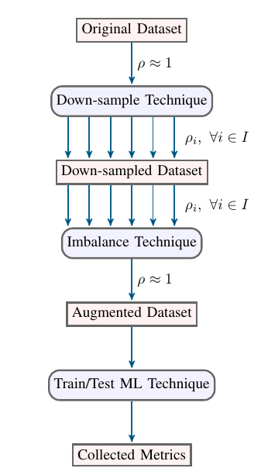
Methodology
Data sets are clean
Induce Imbalance via subsampling
Imbalance technique is applied
New set is evaluated by different classification techniques
Classifier training functions provide equal access to limited flexibility in training (Grid searching)

Slide 11
Analysis
Each Trained Model
F1, Precision, and Recall
Hyperparameters
Operating time
Each Imbalance Technique
Collection of Model Stats
Thus, variance
Algorithmic Methods
Training history is collected as well

Slide 12
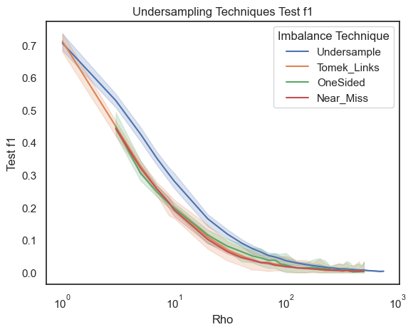
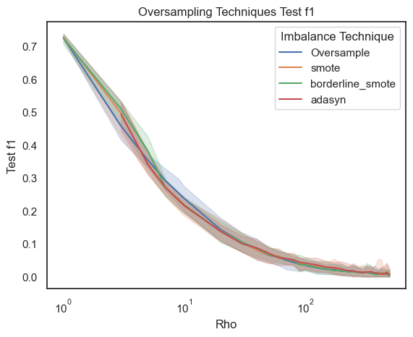
Data Level - Results - Test F1

Slide 13
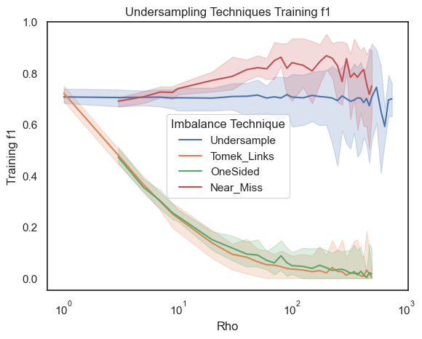
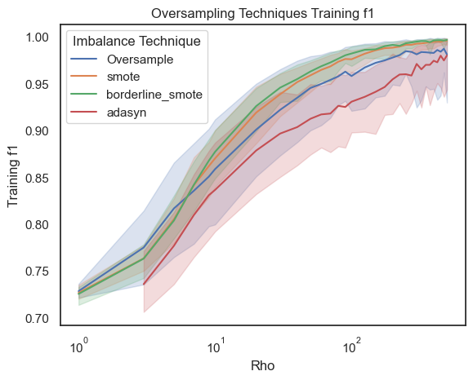
Data Level - Results - Training F1

Slide 14
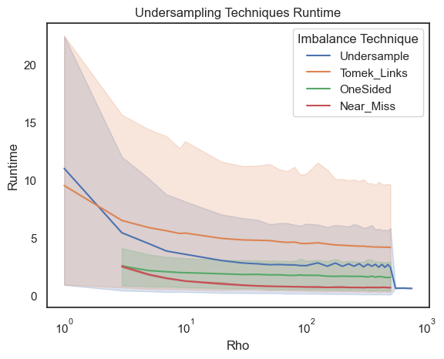
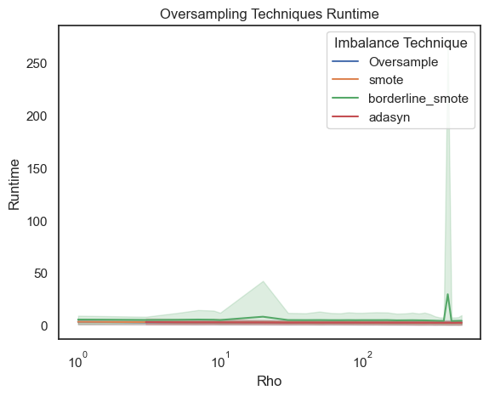
Data Level - Run Time

Slide 15
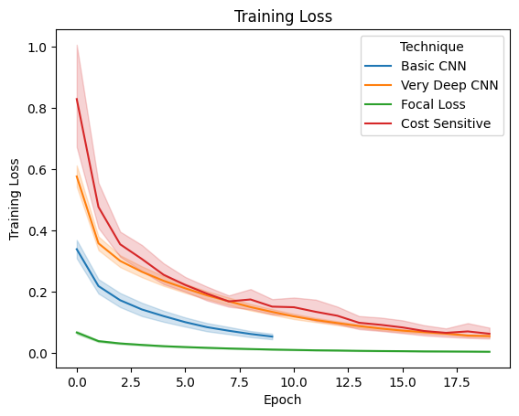
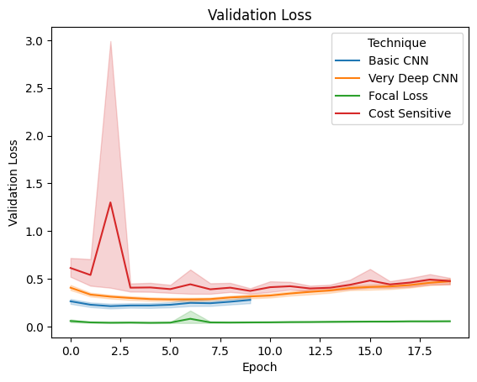
Algorithmic Level - Loss History

Slide 16
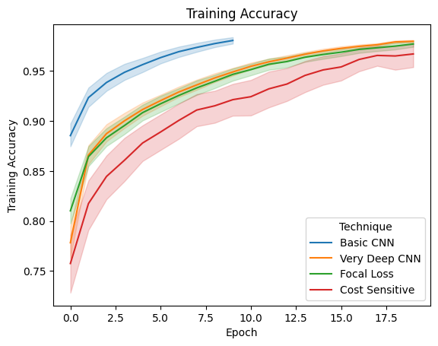
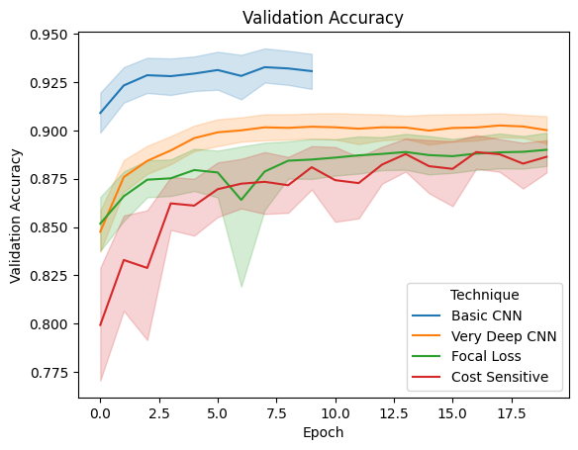
Algorithmic Level - Accuracy History

Slide 17
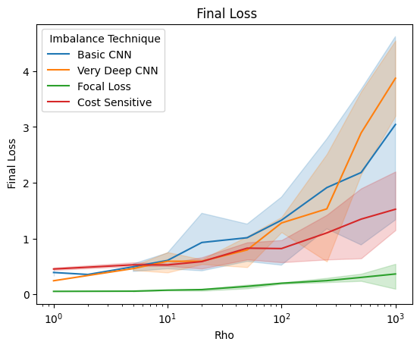
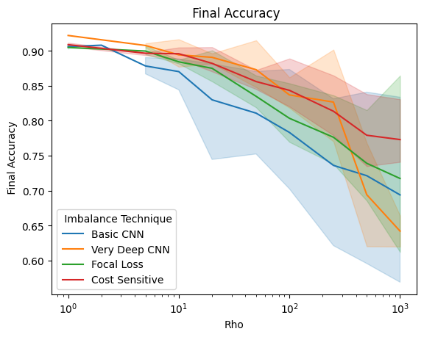
Algorithmic Level - Test Results

Slide 18
Conclusion
Negligible differences between the data level in a naive application
However, one-sided and Tomek-link under sampling produce a validation results that more accurately reflect test performance
The algorithmic methods showed a greater level of robustness, cost tuning does come with lower report training statistics; but produces better final results

Slide 19
Conclusion - Future Work
Non-random downsampling

Slide 20
Questions
?

Slide 21
Citations

